Slide 1
IoT and AI in Electrical Engineering
Exploring the Transformative Impact of Technology

Slide 2
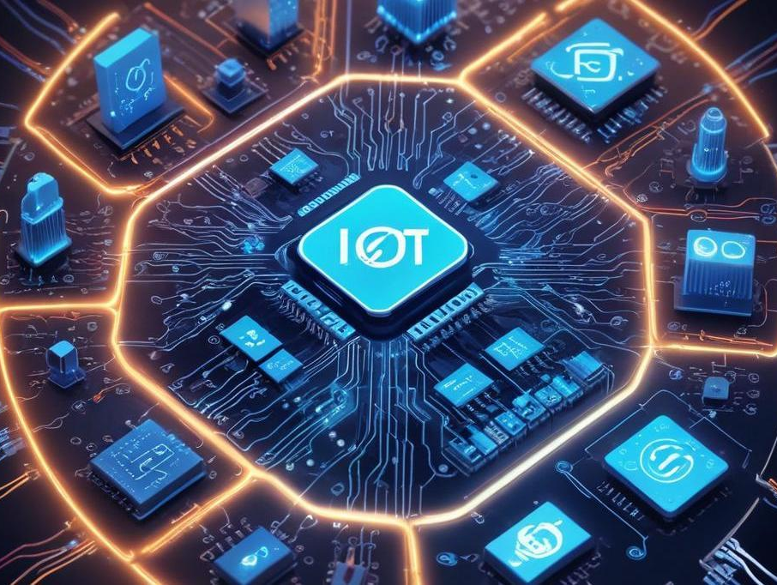
Introduction
This presentation discusses the vital roles of IoT and AI in revolutionizing electrical engineering practices. These technologies enhance automation, efficiency, and predictive capabilities, leading to smarter electrical systems and improved energy management.

Slide 3
Smart Grid Systems
Smart Grid Systems leverage IoT technology for real-time monitoring and control of energy distribution. By utilizing IoT devices, utilities can gather feedback on energy consumption, leading to optimized operations and reduced wastage. These systems enhance reliability and allow for automated responses to fluctuations in energy demand, promoting energy efficiency and sustainability.

Slide 4
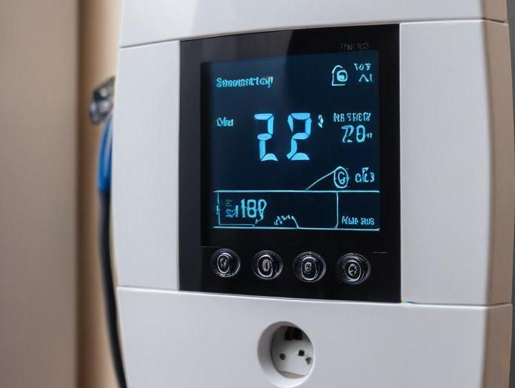
Energy Metering
Energy Metering plays a crucial role in modern electrical engineering through IoT-enabled smart meters that track energy usage in real time. These smart meters allow consumers to monitor their consumption patterns, leading to more accurate billing and energy management. They also facilitate data collection for utilities, helping them to optimize energy distribution and plan for future demand more effectively.

Slide 5
Home Automation
Home Automation integrates IoT devices such as smart thermostats, lighting, and appliances to enhance energy efficiency and user convenience. These devices can be remotely controlled via smartphones or voice assistants, enabling users to optimize energy use based on their habits and preferences. Automation also allows for scheduled activities, such as turning off lights when not in use or adjusting heating and cooling based on occupancy, leading to cost savings and increased comfort.

Slide 6
Fault Detection
Fault Detection employs AI algorithms to analyze data from electrical systems, identifying anomalies and predicting failures before they occur. This proactive maintenance approach minimizes downtime and repair costs by allowing for timely interventions. Advanced machine learning techniques can recognize patterns in data that indicate potential issues, enabling maintenance teams to address problems before they escalate, thus improving system reliability and safety.

Slide 7
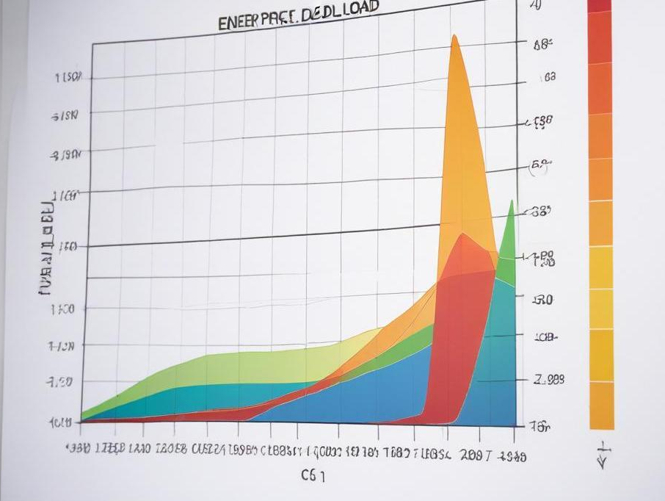
Load Forecasting
Load Forecasting utilizes AI to predict energy demand and supply, which is critical for maintaining grid stability. By analyzing historical consumption data and considering factors such as weather patterns and economic trends, AI models can provide accurate forecasts. These predictions help in adjusting energy production and managing resources efficiently, ultimately reducing energy waste and improving overall system performance.

Slide 8
Smart Grid Optimization
Smart Grid Optimization leverages AI to enhance the efficiency of energy distribution and management. By balancing load distribution among various energy sources and predicting peak demand periods, AI systems facilitate a smoother energy flow and reduce losses. This optimization not only leads to cost savings but also contributes to environmental sustainability by integrating renewable energy sources and reducing carbon footprints.

Slide 9
Conclusions
In conclusion, the integration of IoT and AI in electrical engineering transforms conventional systems into intelligent, efficient, and responsive setups. These advancements enhance productivity, reduce costs, and improve energy management, demonstrating the essential role of technology in the future of electrical engineering.

Slide 10
Thank you!
+91 620 421 838

